Slide 1
Noun-Level Semantic Similarity for Sentence Pair Evaluation Using Token Embeddings
UMAP and Heatmap Visualizations

Slide 2
Goal
Compare the Token-Level Nouns (NOUN and PROPN) from each sentence pair
Compares each noun in the ground-truth sentence to all nouns in the corresponding generated sentence
Compute a similarity for the pair of sentences based on these Token-to-Token similarities.
Plot using Uniform Manifold Approximation and Projection (UMAP)
Plot using Heatmap

Slide 3
What is UMAP?
Dimensionality Reduction Technique
Takes High-Dimensional Vectors
Embeddings of the PoS Noun tokens from SentenceTransformer
Projects Vectors down to 2-Dimensions so they can be visualized in a scatter plot

Slide 4
UMAP Steps
For a sentence pair (ground-truth vs. generated):
Extract nouns (or noun phrases) from both sentences.
Embed each noun using a SentenceTransformer:
Model: SciBERT (allenai/scibert_scivocab_uncased)
URL: https://huggingface.co/allenai/scibert_scivocab_uncased
Details: Pre-trained BERT model trained on massive corpus of scientific papers from semanticscholar.org
Project Embeddings to 2D Using UMAP
Combine the ground-truth and generated embeddings into a single matrix.
Apply UMAP for dimensionality reduction to output 2D coordinates for visualization.
Parameters:
n_neighbors (6) – very local structure (more sensitive to noise)
Controls local vs. global structure (default: 15)
min_dist (0.3) – moderate spacing
Controls compactness of clusters (default: 0.1)
random_state (1): For reproducibility
Visualize Using Plotly Subplots

Slide 5
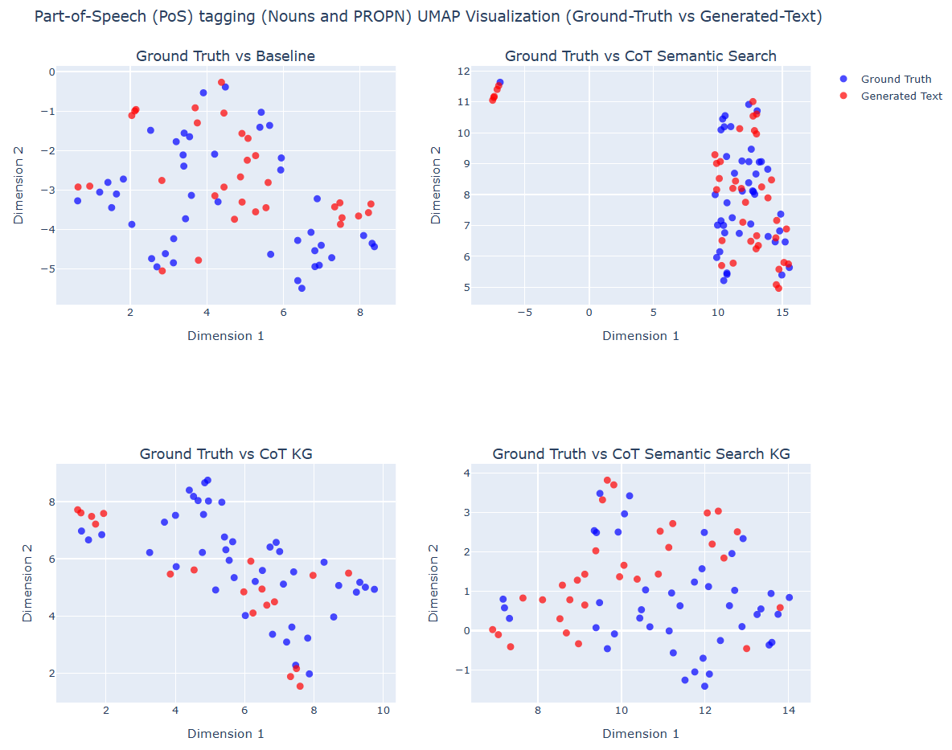
Sample #1
Clinical Case B:
ICD Code: K08109
Text Reference: edentulism
Result Samples:
BASELINE_R003_GENERATED_TEXT
COTSS_R005_GENERATED_TEXT
COTKG_R009_GENERATED_TEXT
COTSSKG_R006_GENERATED_TEXT
CoT Semantic Search KG exhibit tightly interleaved noun clusters with ground truth, while Baseline shows more dispersed and mismatched noun groupings.
The chosen parameters n_neighbors (6) and min_dist (0.3) effectively highlight lexical and conceptual precision in generated outputs

Slide 6
Heatmap Steps
For a sentence pair (ground-truth vs. generated):
Extract nouns (or noun phrases) from both sentences.
Embed each noun using a SentenceTransformer:
Model: SciBERT (allenai/scibert_scivocab_uncased)
URL: https://huggingface.co/allenai/scibert_scivocab_uncased
Details: Pre-trained BERT model trained on massive corpus of scientific papers from semanticscholar.org
Compute Cosine Similarity Matrix
Encode the nouns (ground-truth and generated text) separately
Compute pairwise cosine similarity (e.g., util.cos_sim) from SBERT
Collect the similarity scores
Plot the Cosine Heatmap (using seaborn)
X-axis – Generated Nouns
Y-axis – Ground-truth Nouns

Slide 7
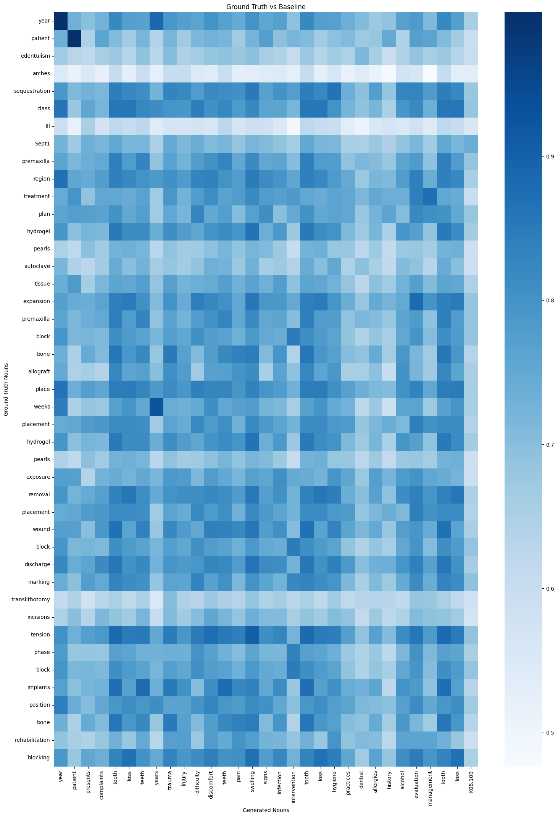
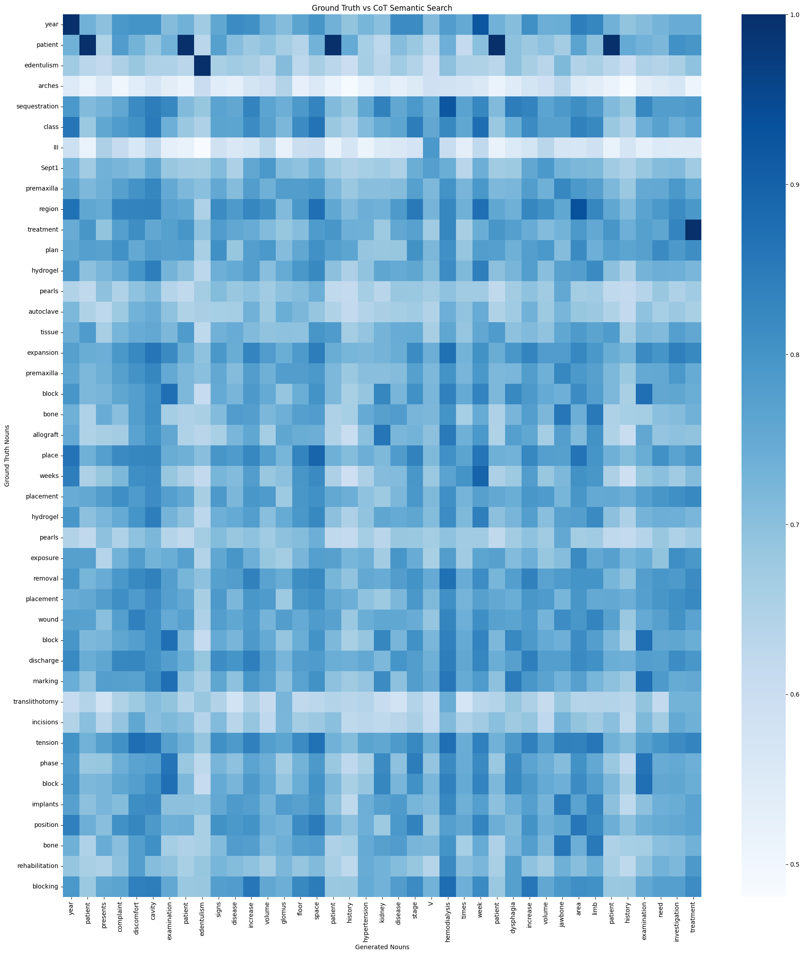
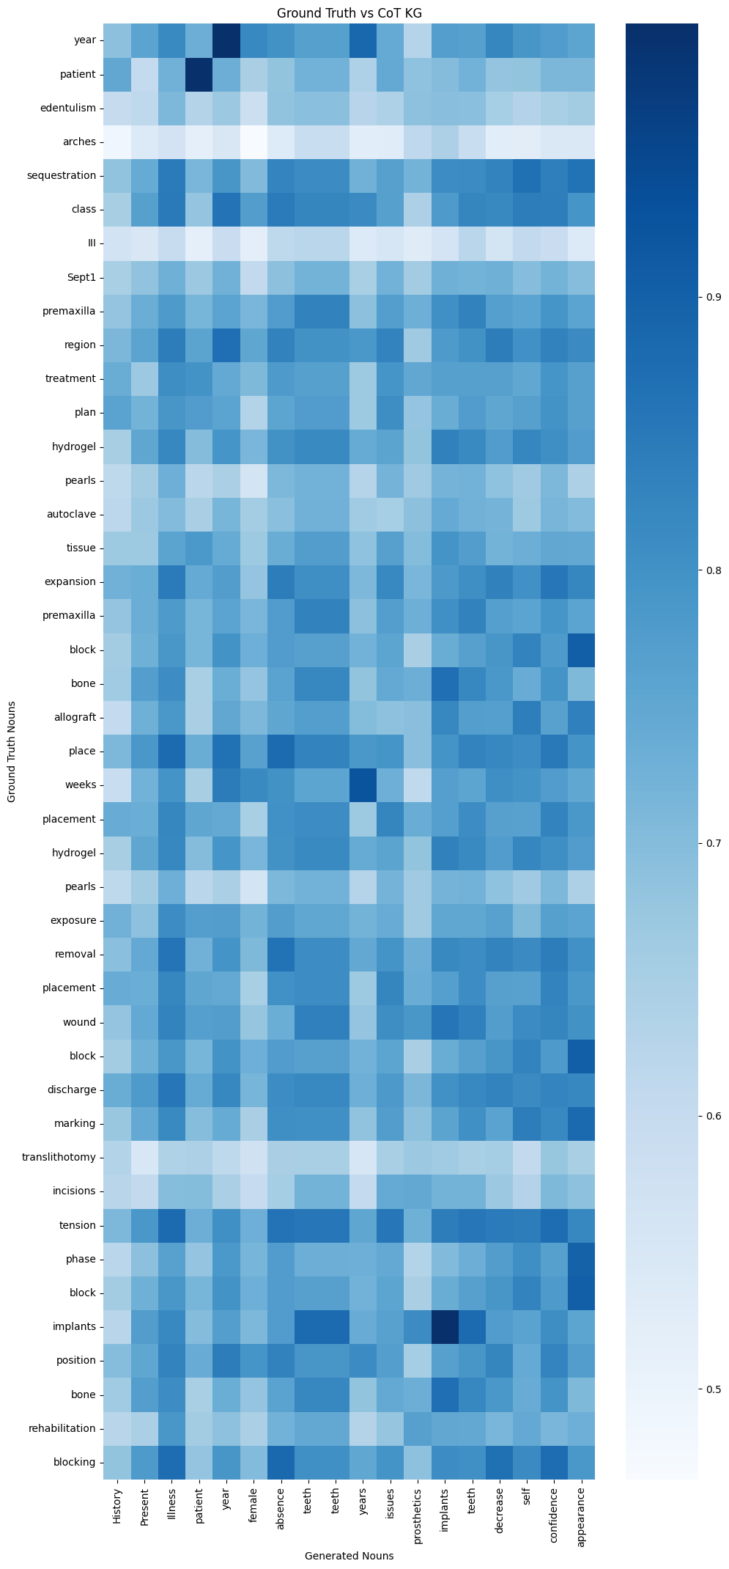
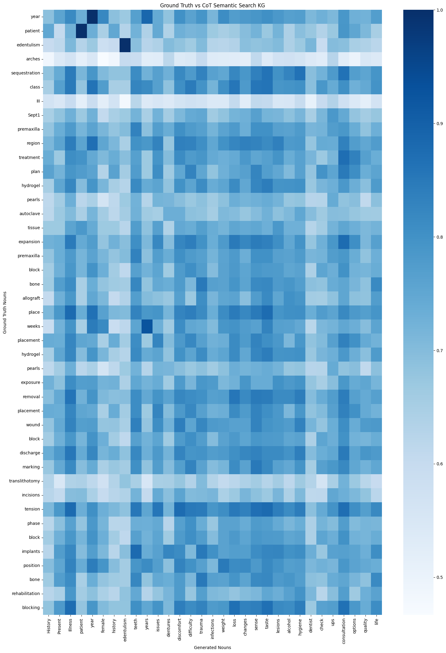
Sample #1
Clinical Case B:
ICD Code: K08109
Text Reference: edentulism
Result Samples:
BASELINE_R003_GENERATED_TEXT
COTSS_R005_GENERATED_TEXT
COTKG_R009_GENERATED_TEXT
COTSSKG_R006_GENERATED_TEXT
Year,
Patient
Edentulism
Baseline
CoT Semantic Search
CoT KG
CoT KG SS

Slide 9
Backup Slides

Slide 10
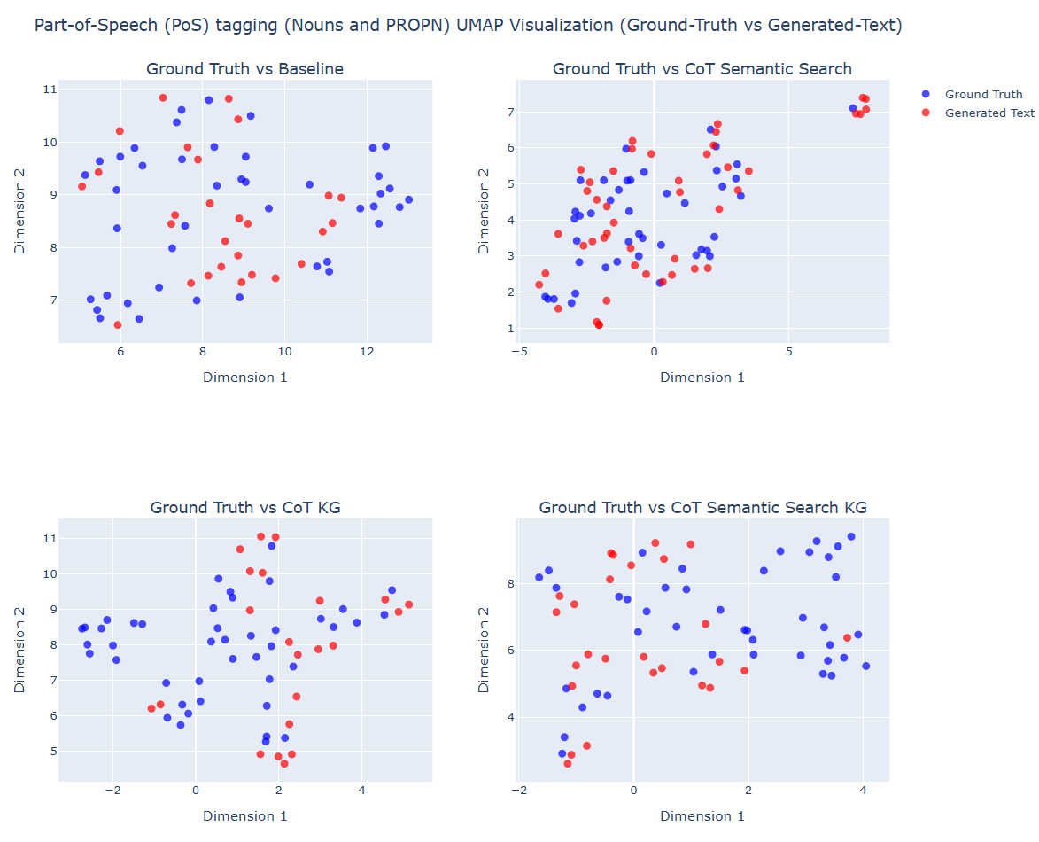
Sample #2
Clinical Case B:
ICD Code: K08109
Text Reference: edentulism
Result Samples:
BASELINE_R041_GENERATED_TEXT
COTSS_R044_GENERATED_TEXT
COTKG_R028_GENERATED_TEXT
COTSSKG_R033_GENERATED_TEXT
CoT Semantic Search KG exhibit tightly interleaved noun clusters with ground truth, while Baseline shows more dispersed and mismatched noun groupings.
The chosen parameters n_neighbors (6) and min_dist (0.3) effectively highlight lexical and conceptual precision in generated outputs

Slide 11
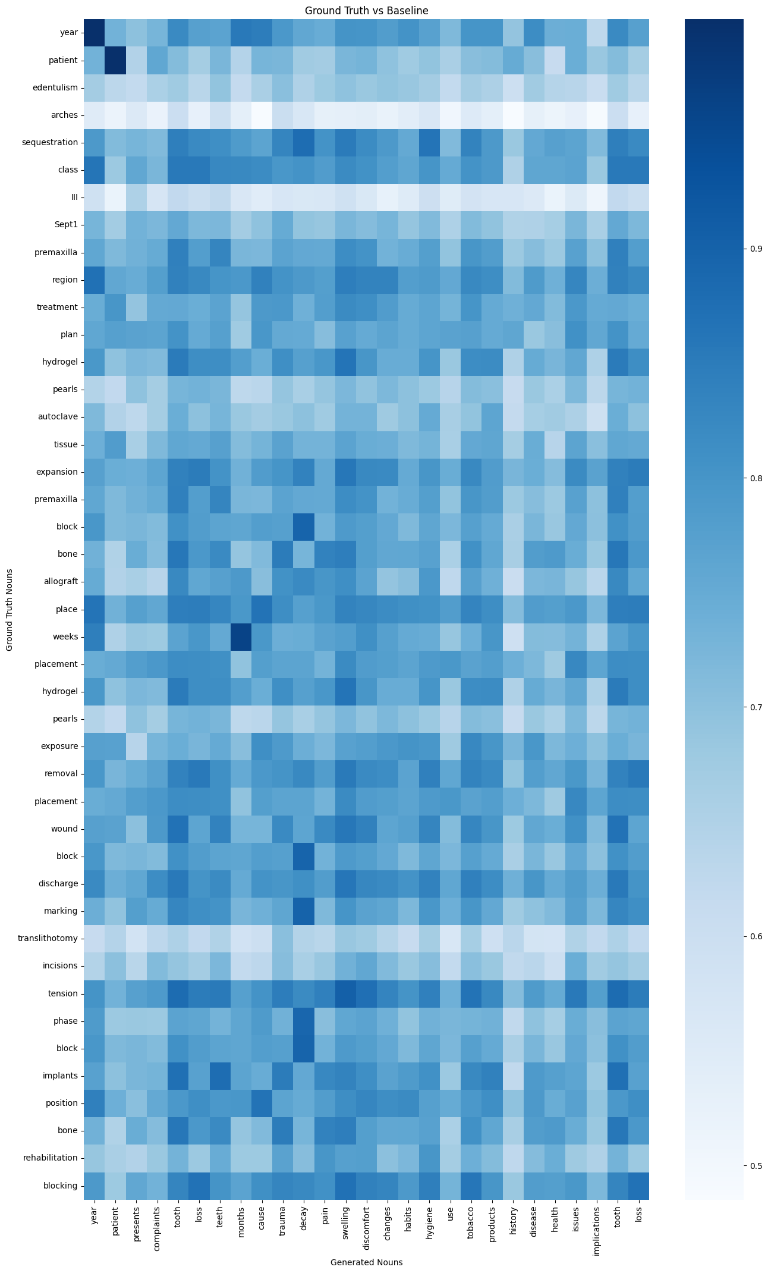
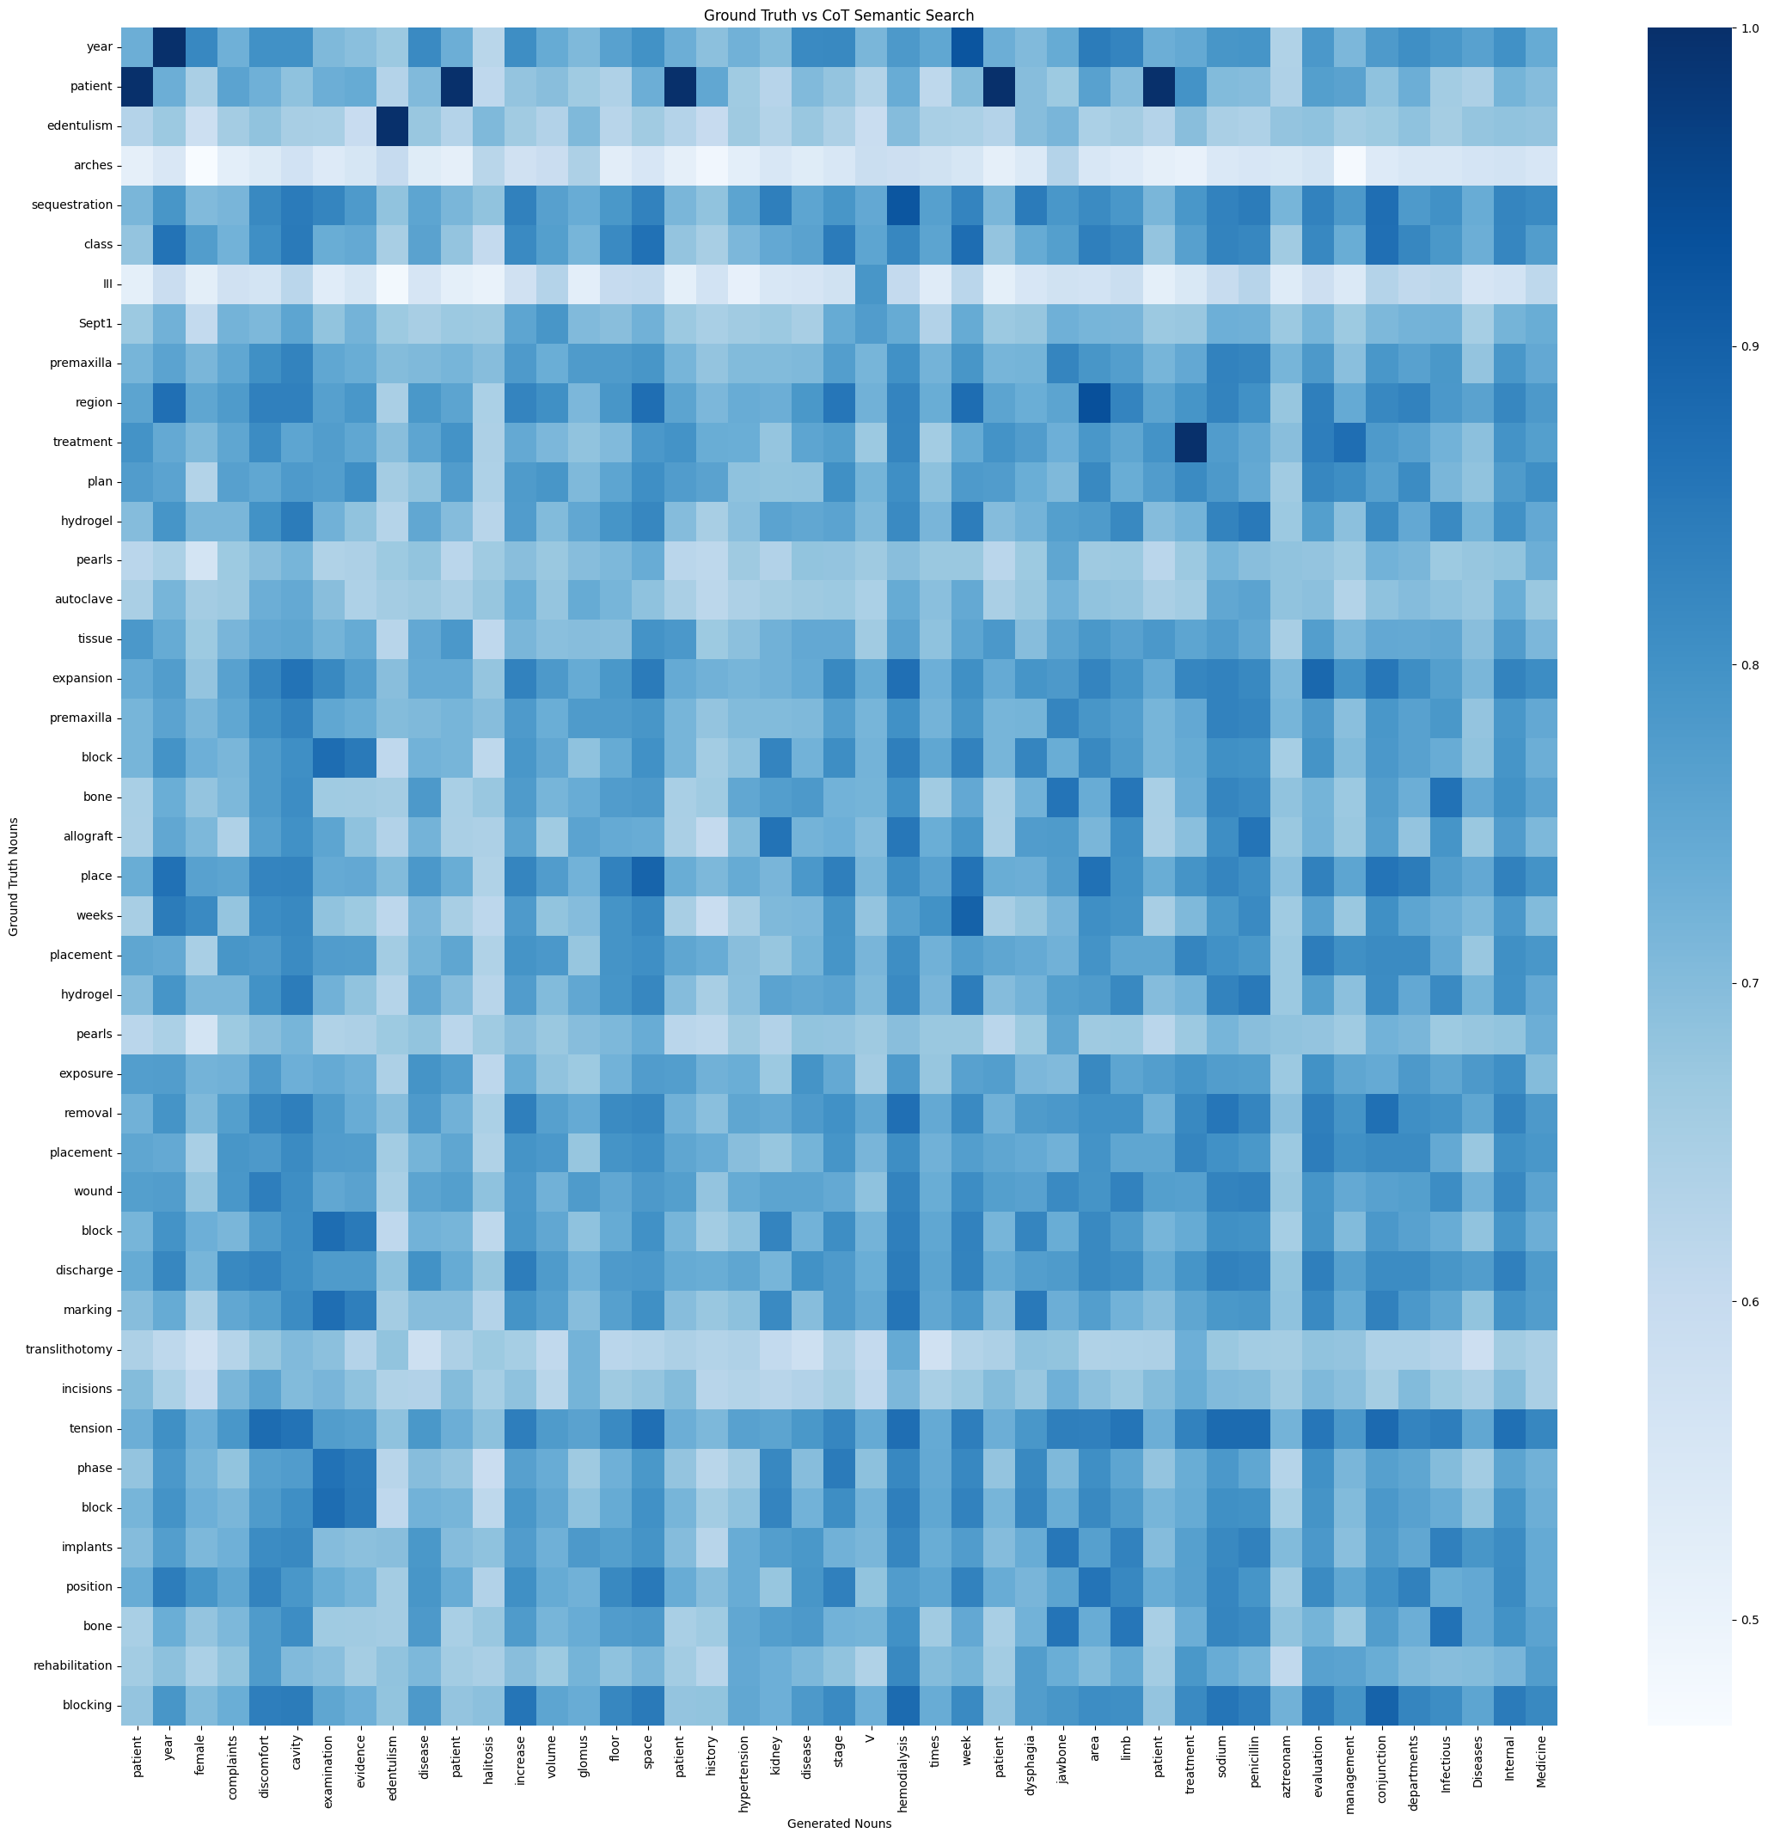
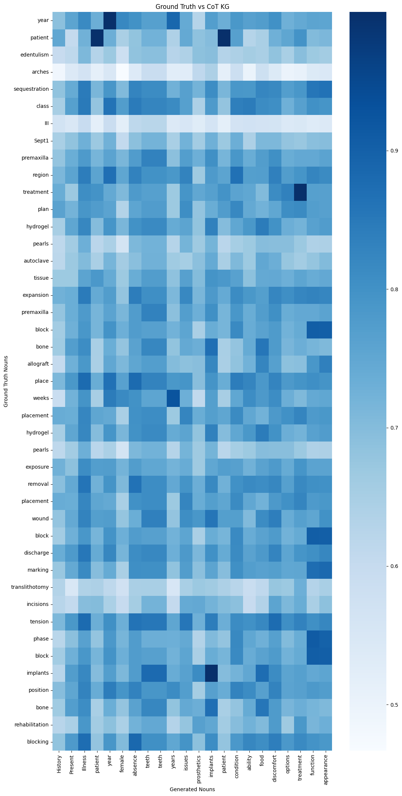
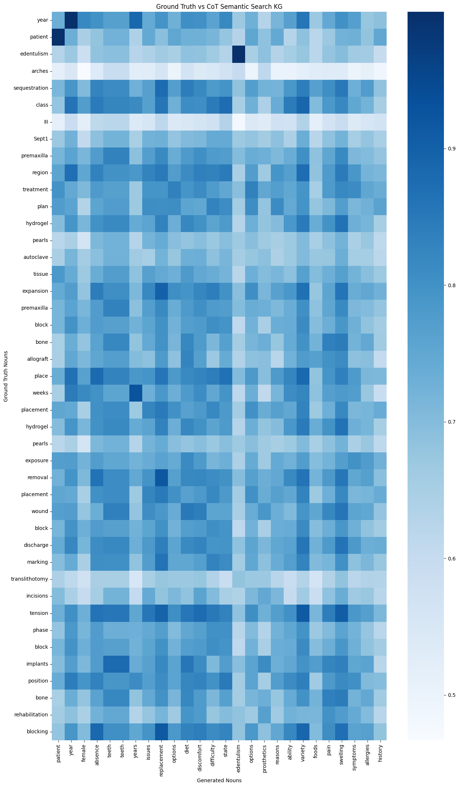
Sample #2
Clinical Case B:
ICD Code: K08109
Text Reference: edentulism
Result Samples:
BASELINE_R041_GENERATED_TEXT
COTSS_R044_GENERATED_TEXT
COTKG_R028_GENERATED_TEXT
COTSSKG_R033_GENERATED_TEXT
Baseline
CoT Semantic Search
CoT KG
CoT KG SS

Slide 12
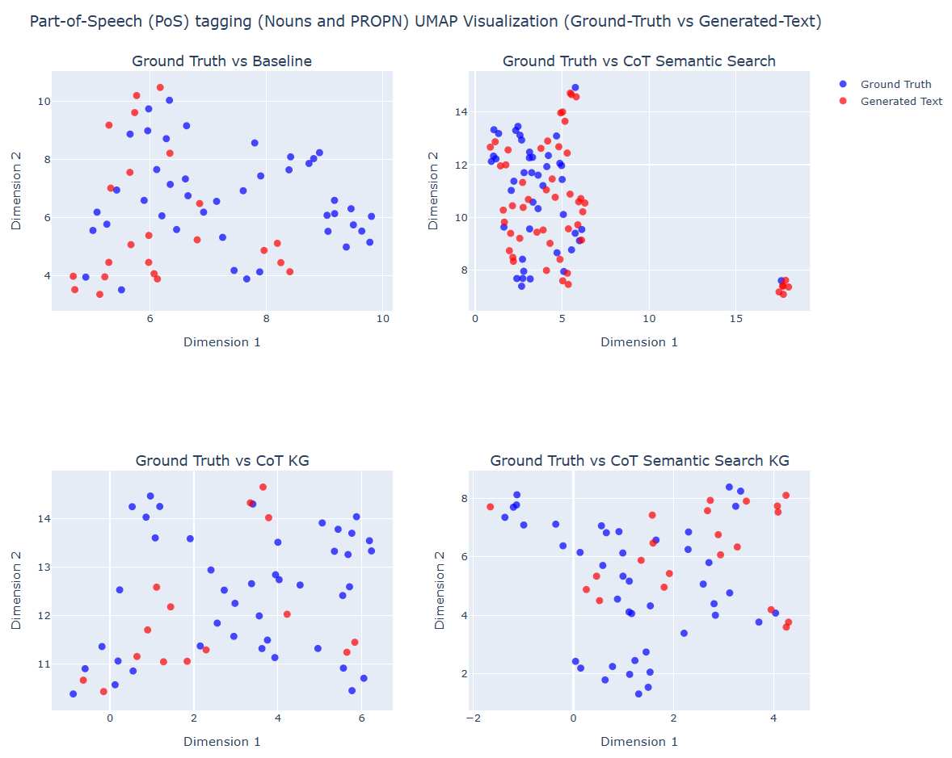
Sample #3
Clinical Case B:
ICD Code: K08109
Text Reference: edentulism
Result Samples:
BASELINE_R068_GENERATED_TEXT
COTSS_R057_GENERATED_TEXT
COTKG_R042_GENERATED_TEXT
COTSSKG_R051_GENERATED_TEXT
CoT Semantic Search KG exhibit tightly interleaved noun clusters with ground truth, while Baseline shows more dispersed and mismatched noun groupings.
The chosen parameters n_neighbors (6) and min_dist (0.3) effectively highlight lexical and conceptual precision in generated outputs

Slide 13
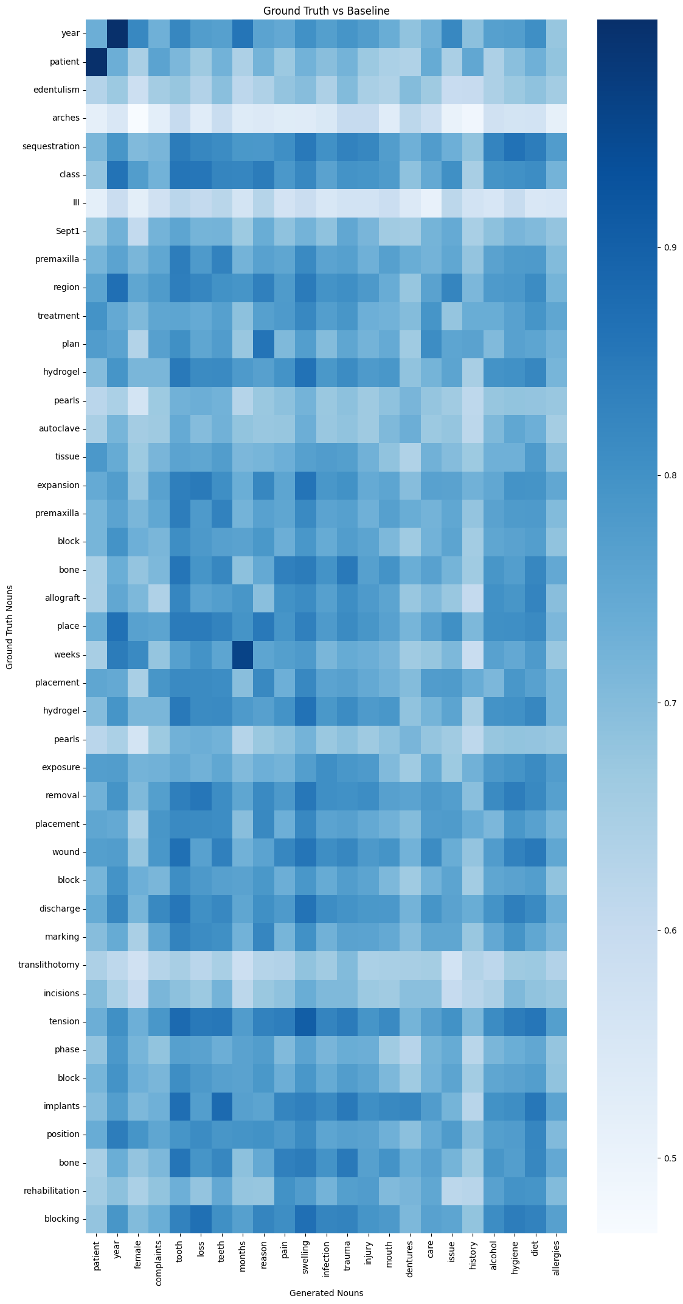
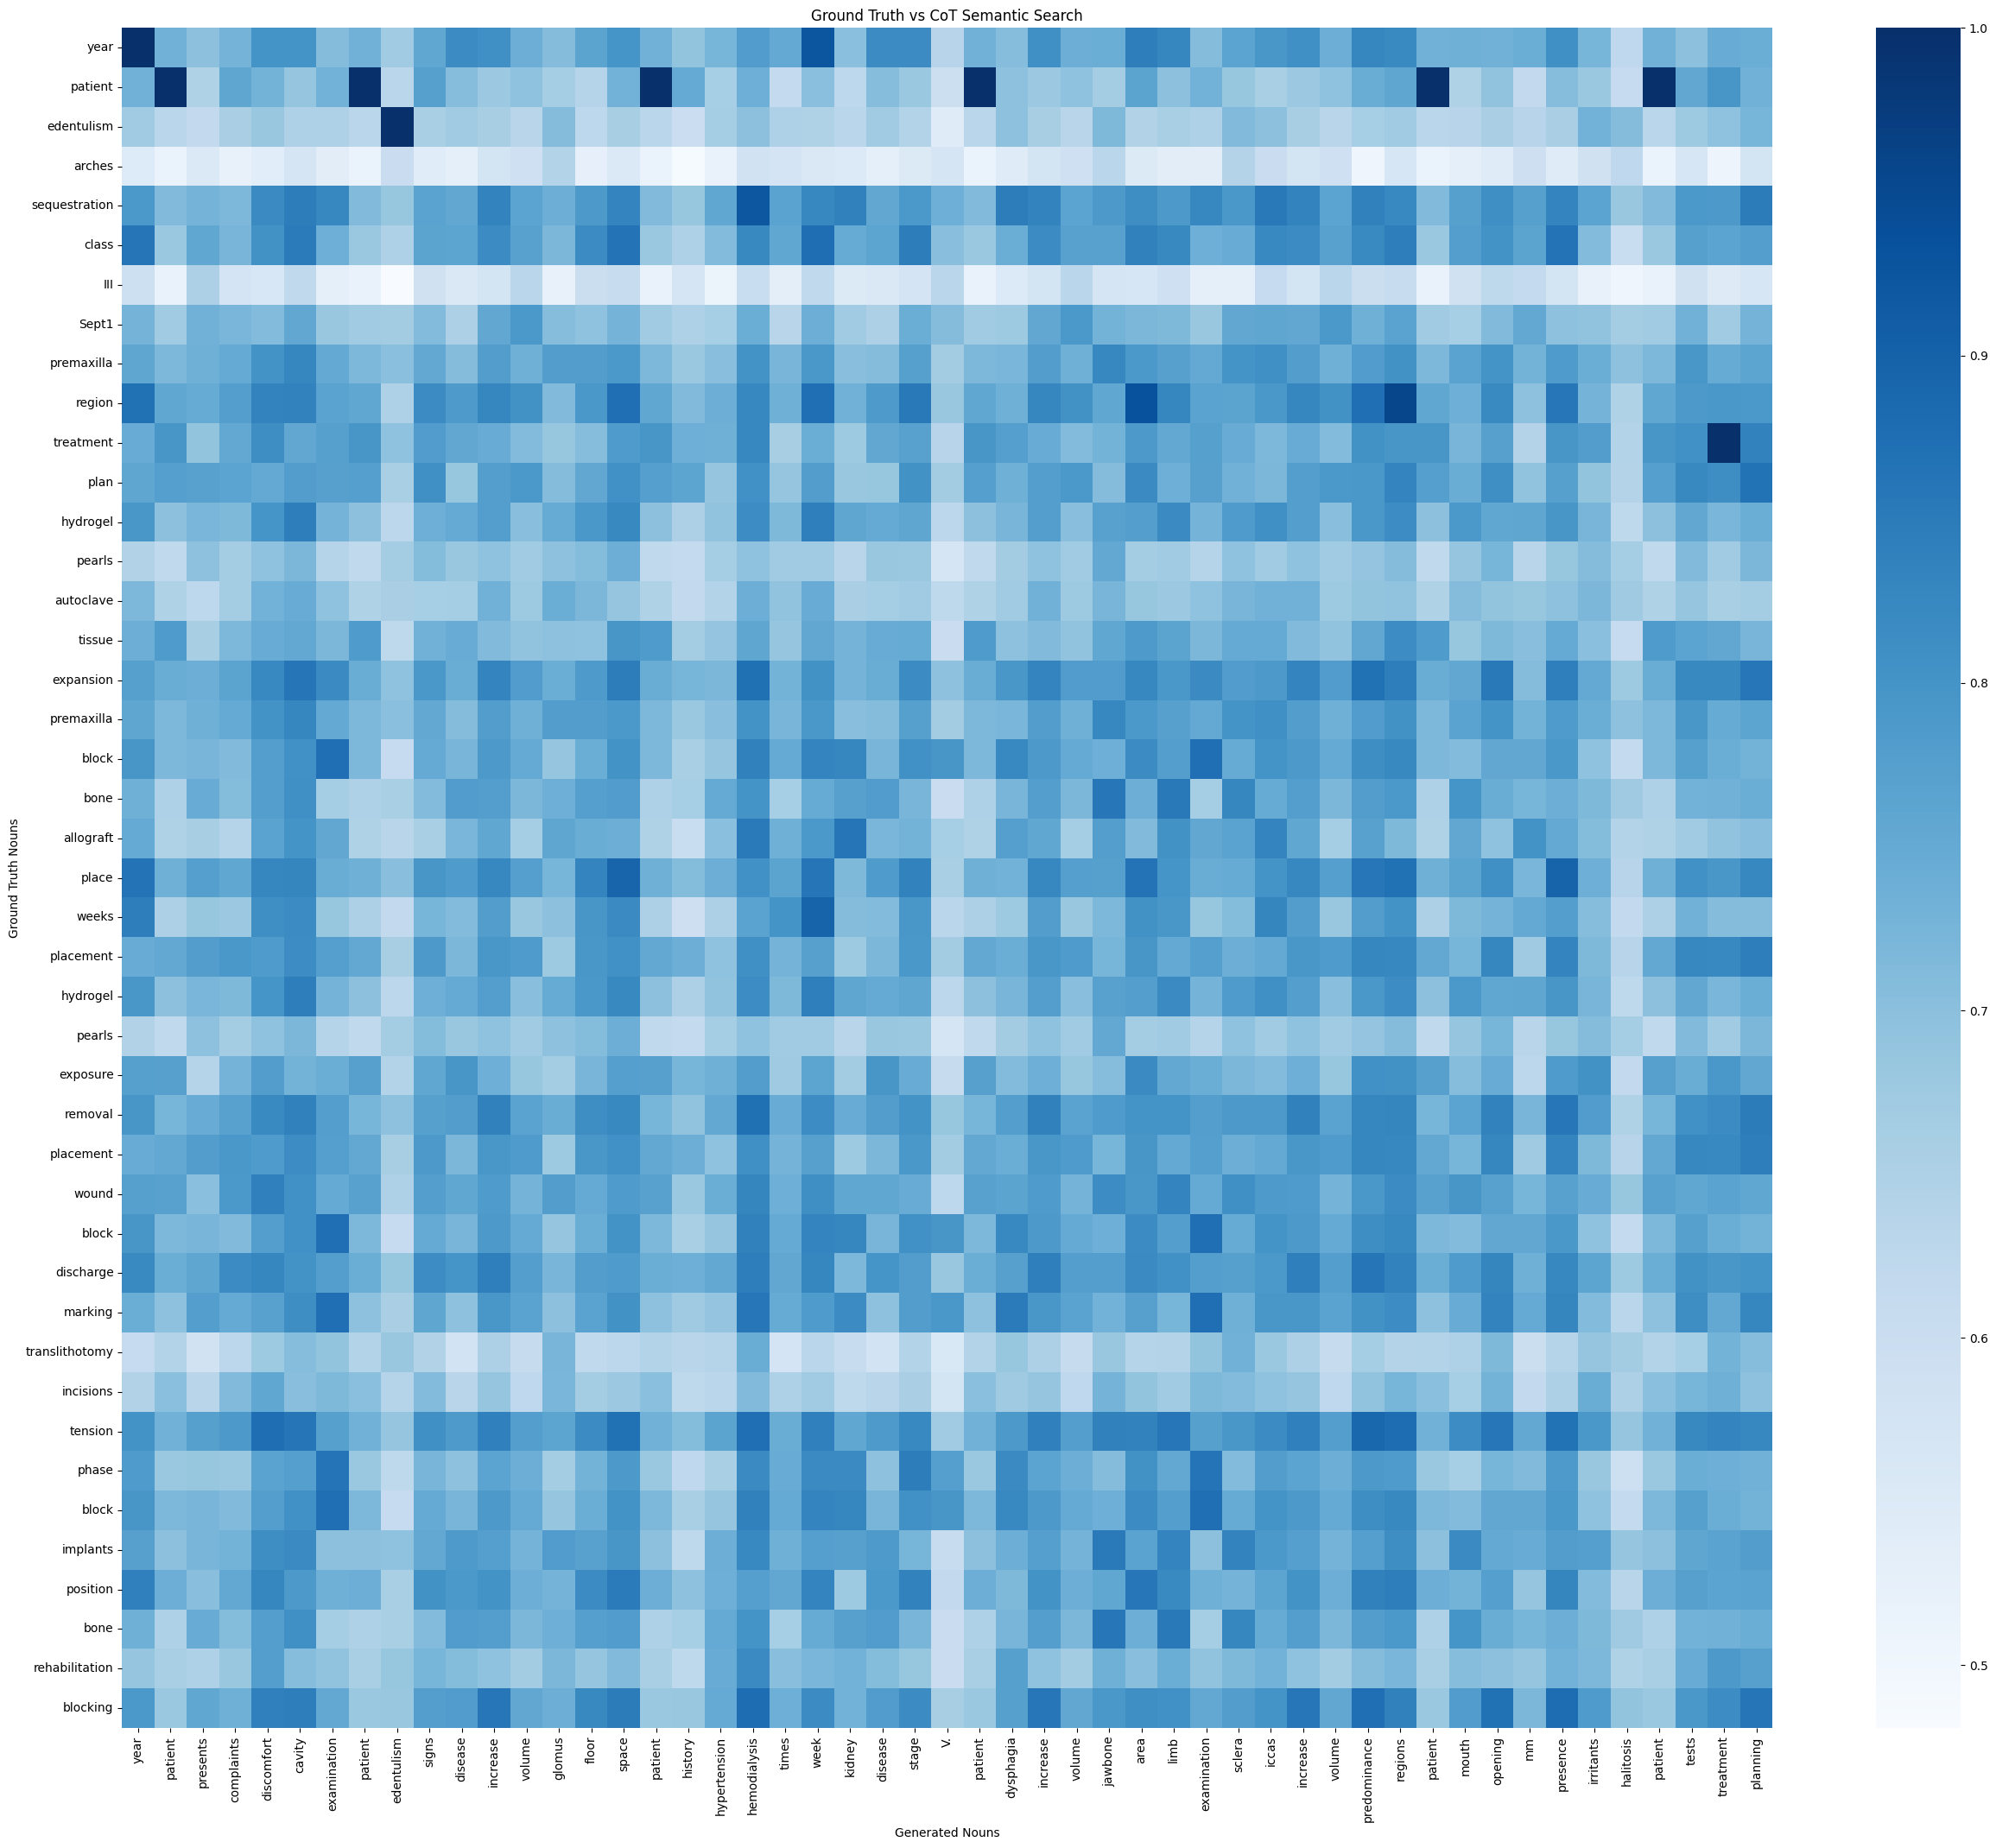
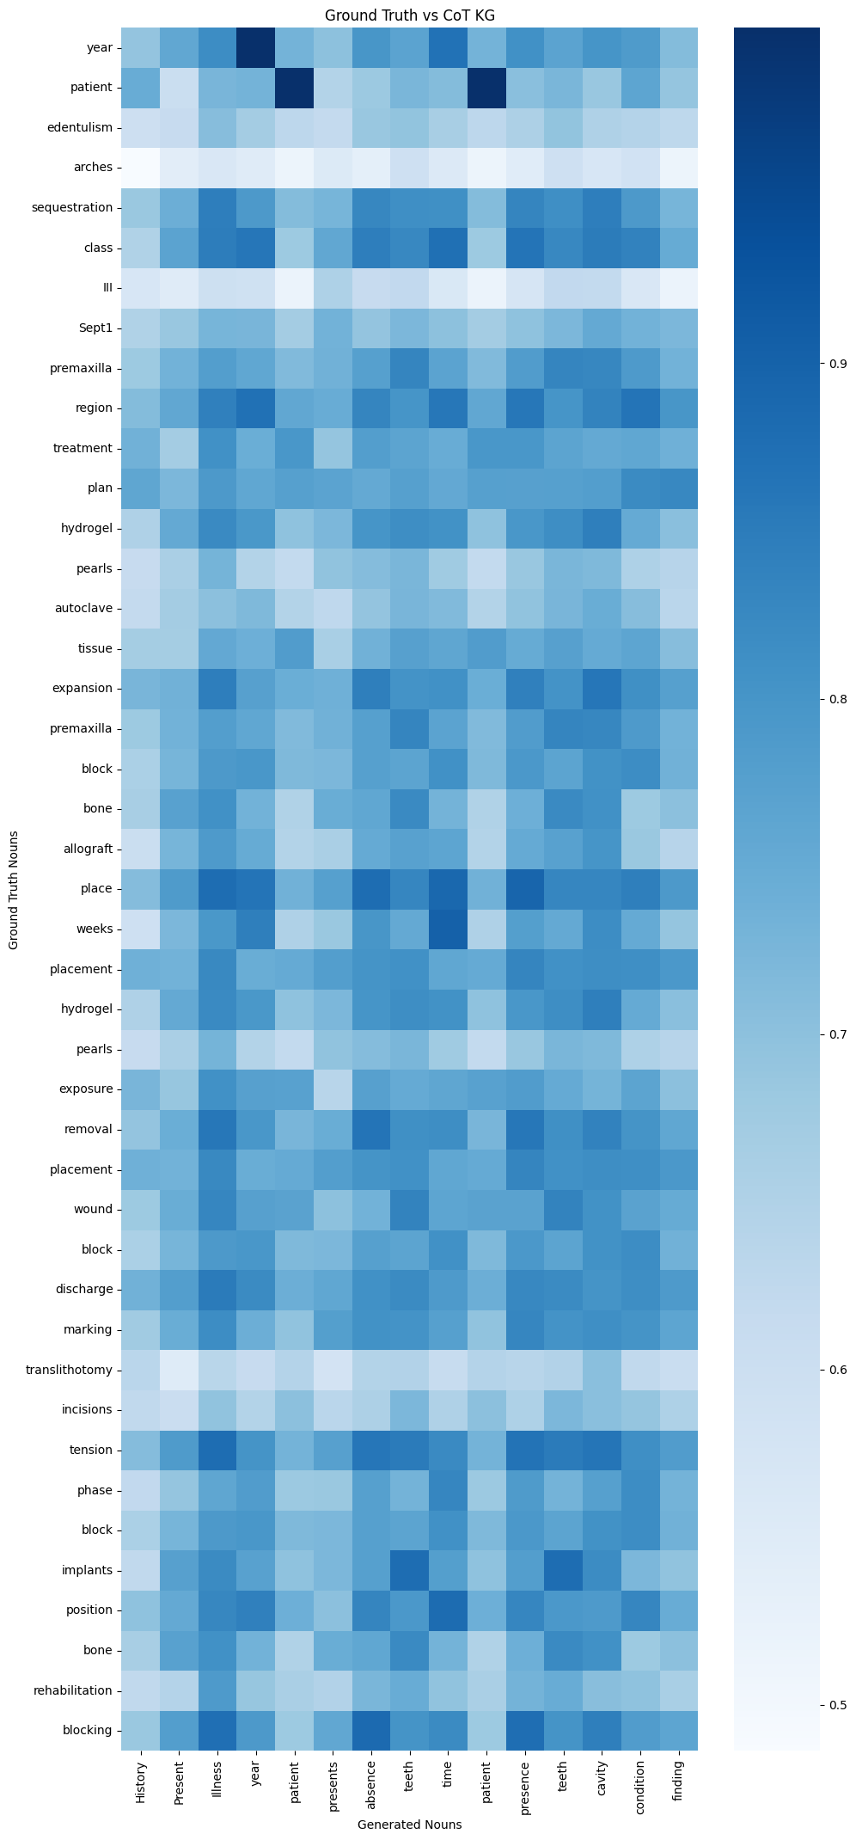
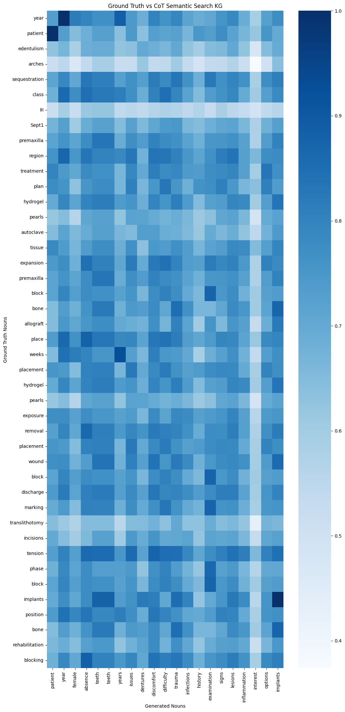
Sample #3
Clinical Case B:
ICD Code: K08109
Text Reference: edentulism
Result Samples:
BASELINE_R068_GENERATED_TEXT
COTSS_R057_GENERATED_TEXT
COTKG_R042_GENERATED_TEXT
COTSSKG_R051_GENERATED_TEXT
Baseline
CoT Semantic Search
CoT KG
CoT KG SS

Slide 14
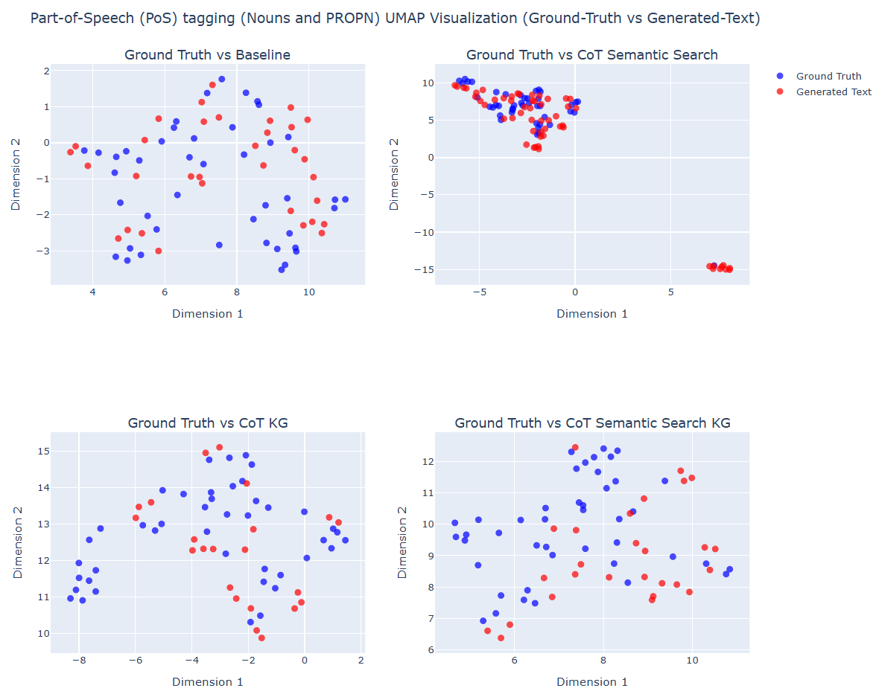
Sample #4
Clinical Case B:
ICD Code: K08109
Text Reference: edentulism
Result Samples:
BASELINE_R088_GENERATED_TEXT
COTSS_R074_GENERATED_TEXT
COTKG_R069_GENERATED_TEXT
COTSSKG_R065_GENERATED_TEXT
CoT Semantic Search KG exhibit tightly interleaved noun clusters with ground truth, while Baseline shows more dispersed and mismatched noun groupings.
The chosen parameters n_neighbors (6) and min_dist (0.3) effectively highlight lexical and conceptual precision in generated outputs

Slide 15
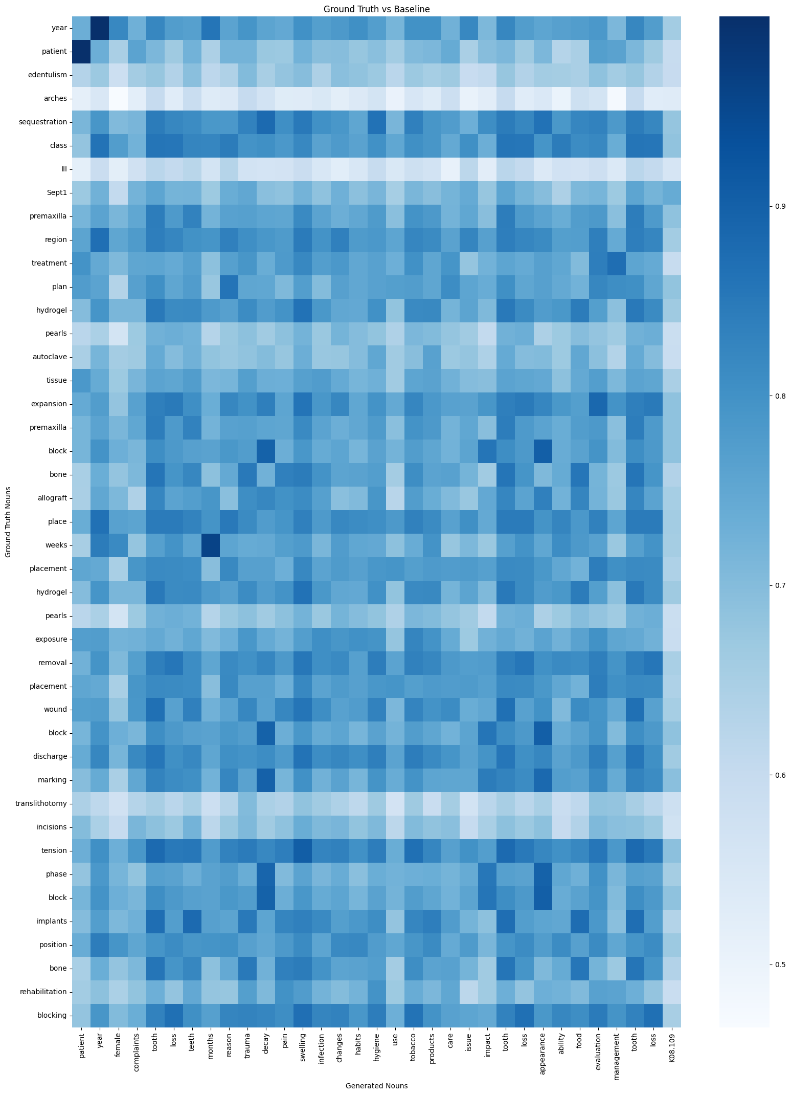
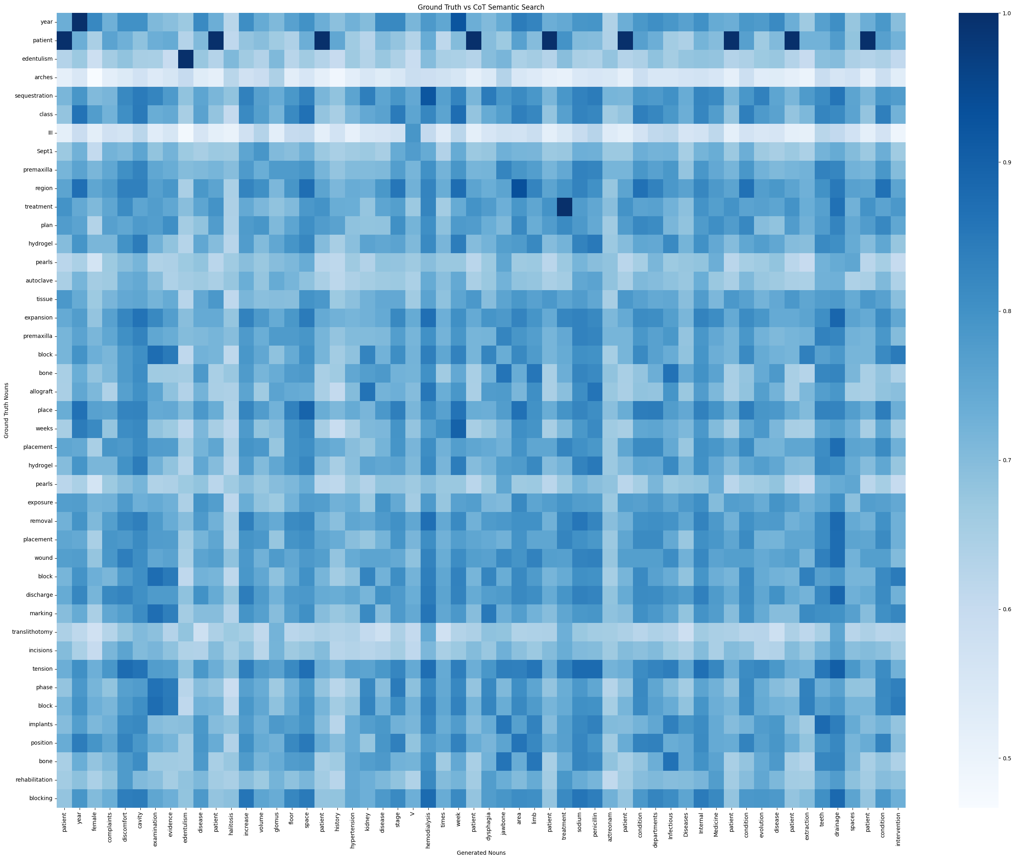
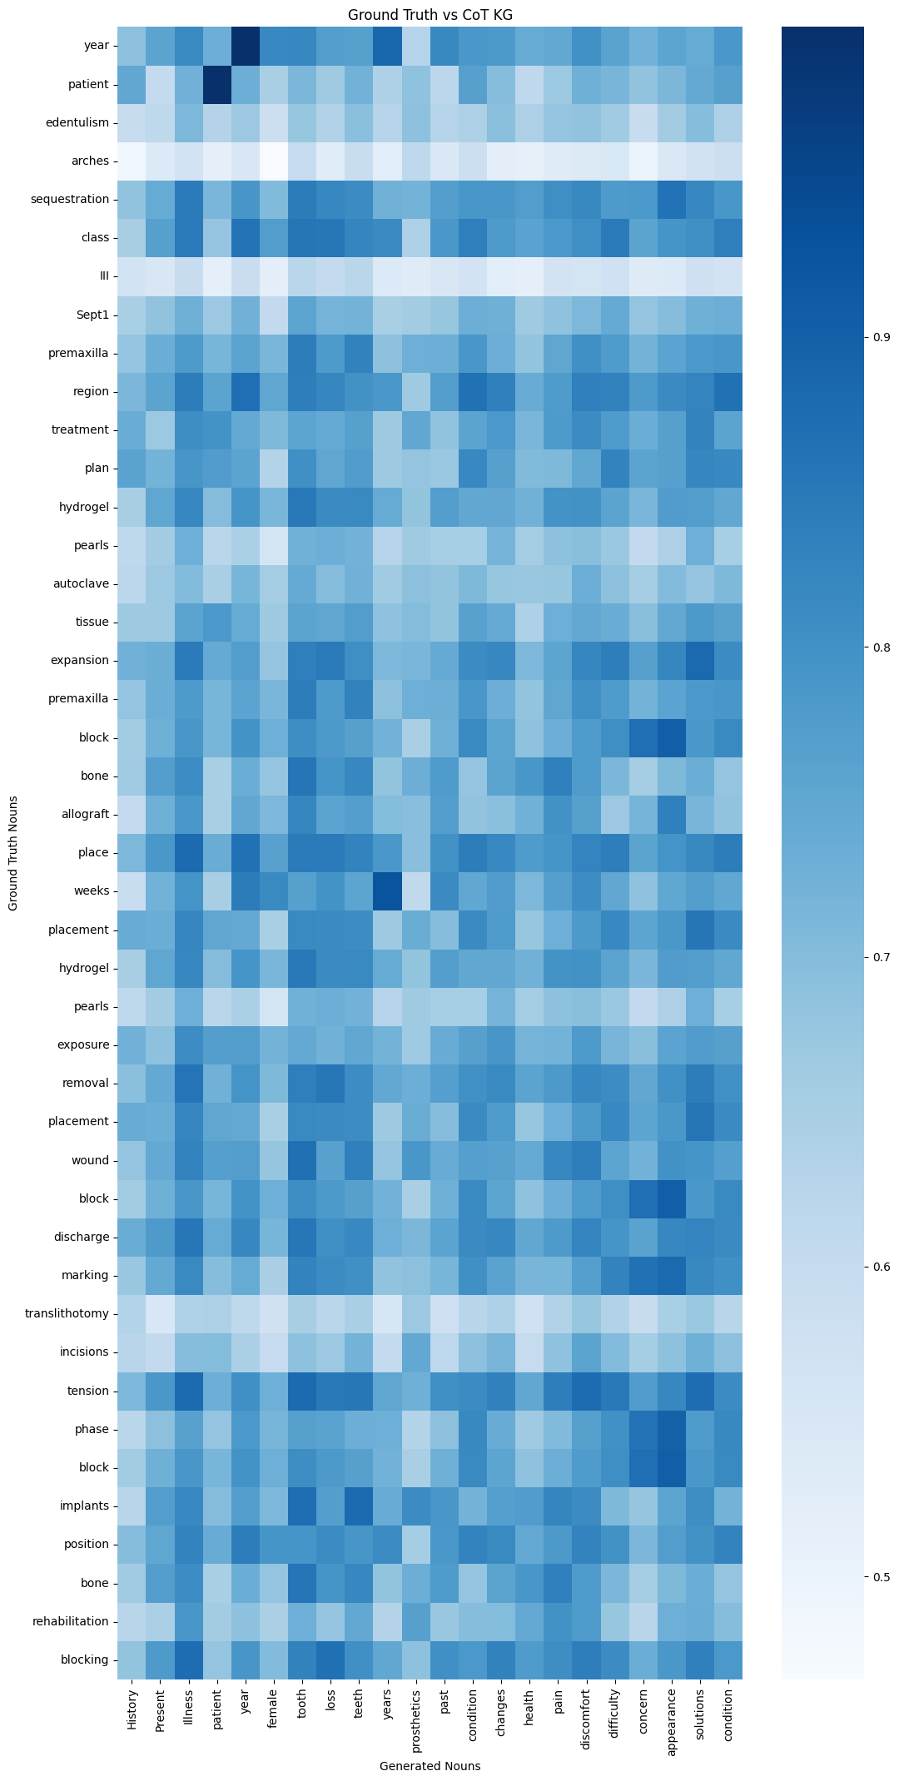
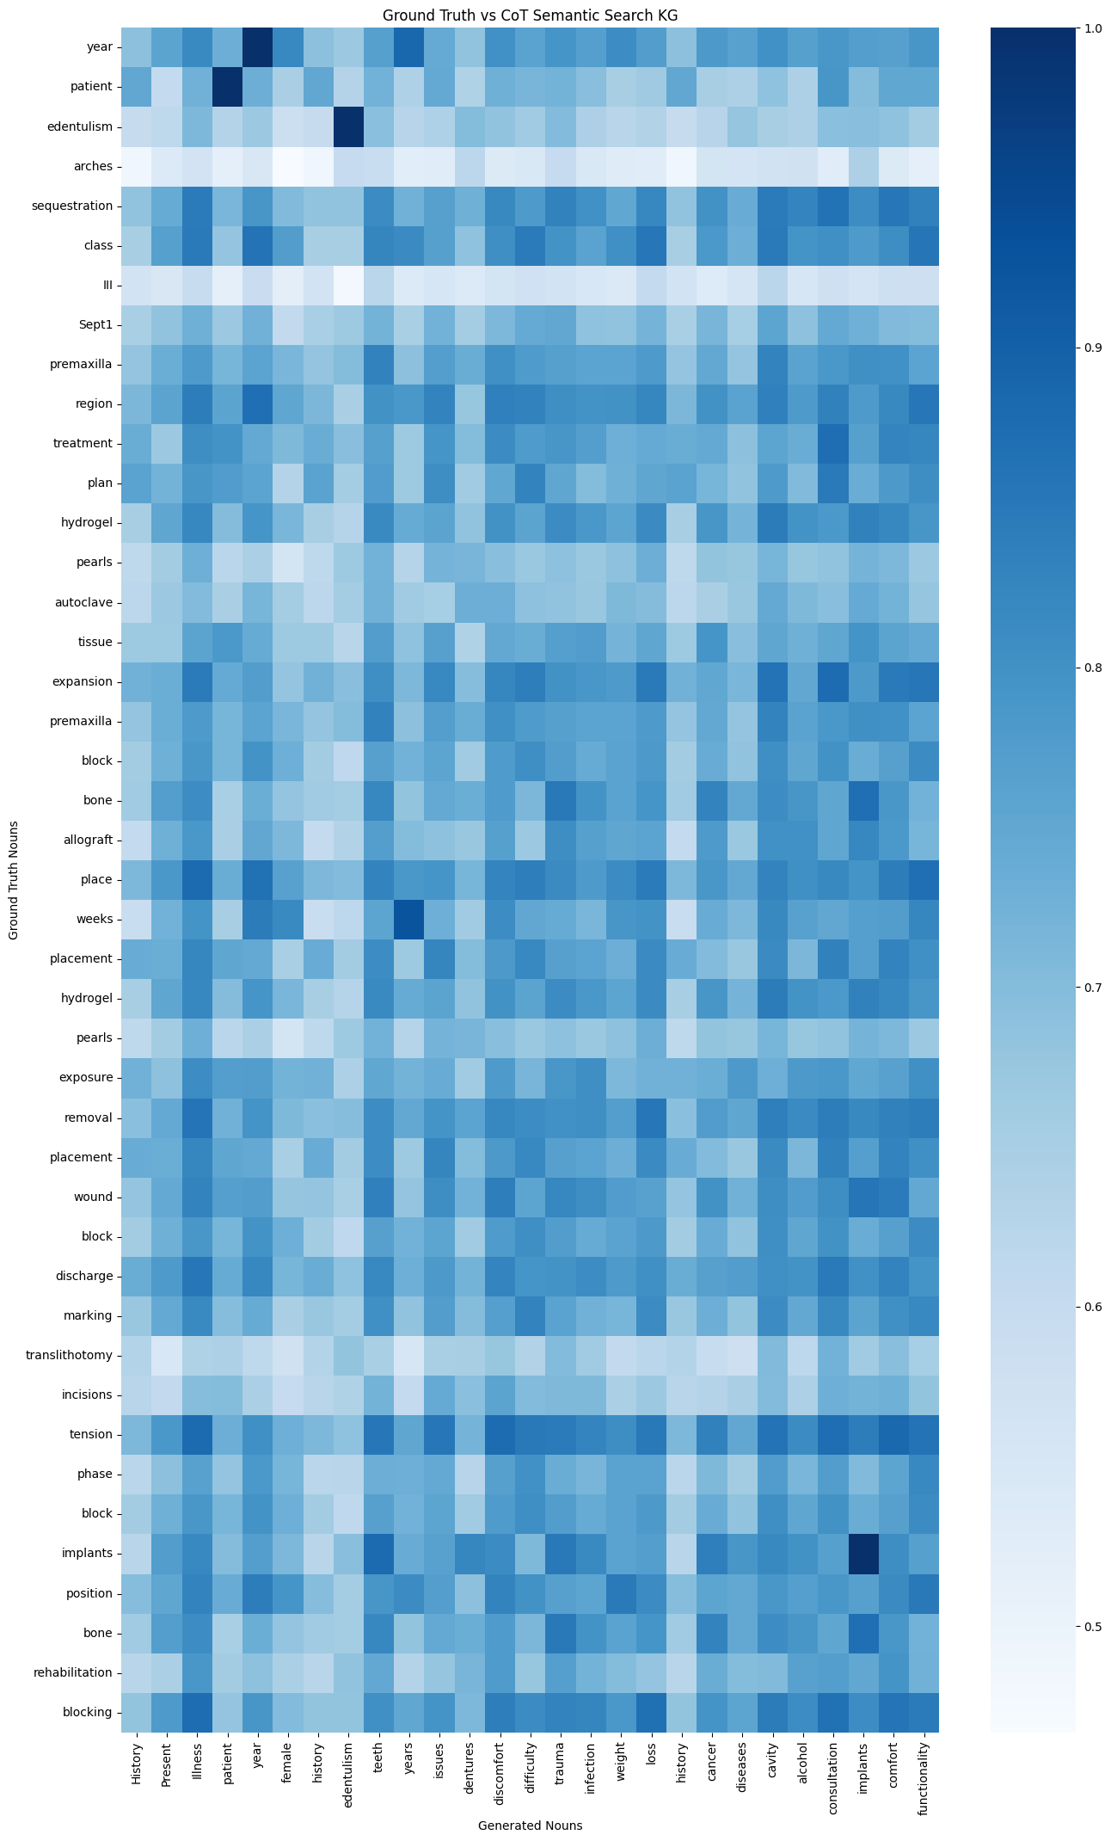
Sample #4
Clinical Case B:
ICD Code: K08109
Text Reference: edentulism
Result Samples:
BASELINE_R088_GENERATED_TEXT
COTSS_R074_GENERATED_TEXT
COTKG_R069_GENERATED_TEXT
COTSSKG_R065_GENERATED_TEXT
Baseline
CoT Semantic Search
CoT KG
CoT KG SS

Slide 16
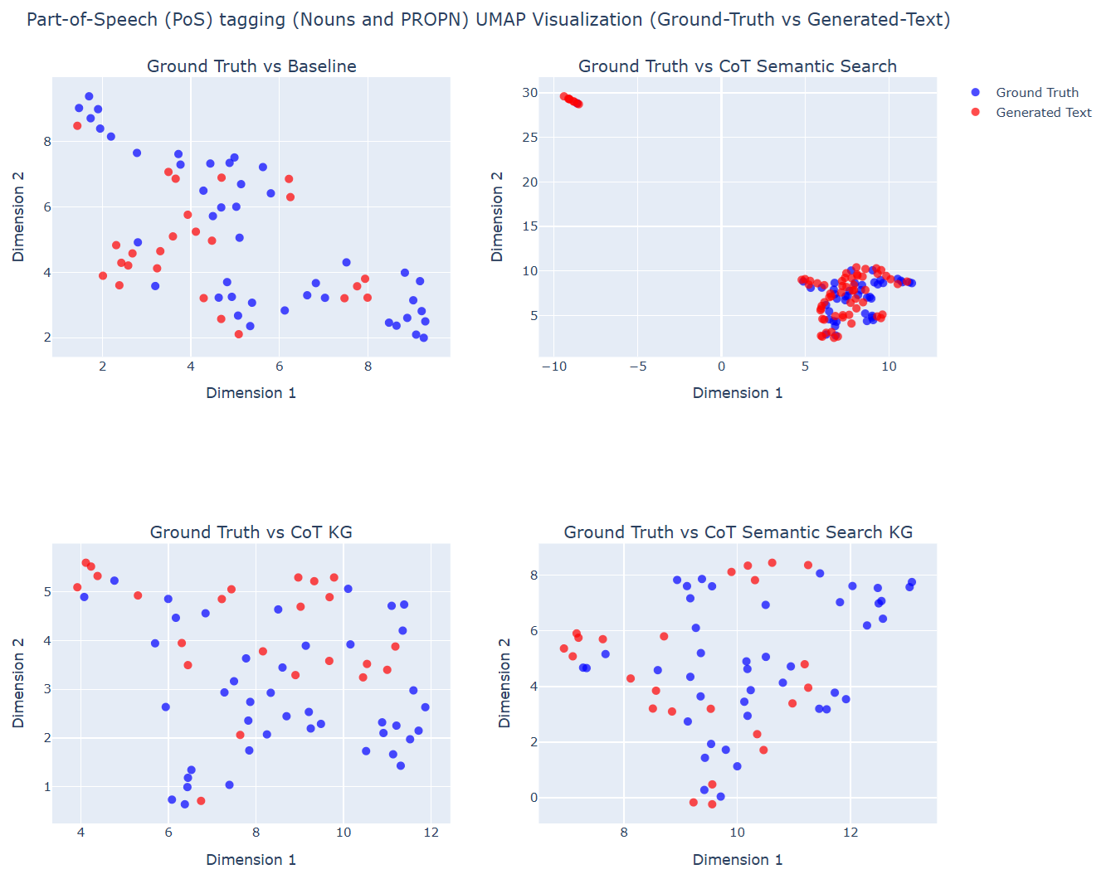
Sample #5
Clinical Case B:
ICD Code: K08109
Text Reference: edentulism
Result Samples:
BASELINE_R096_GENERATED_TEXT
COTSS_R095_GENERATED_TEXT
COTKG_R084_GENERATED_TEXT
COTSSKG_R078_GENERATED_TEXT
CoT Semantic Search KG exhibit tightly interleaved noun clusters with ground truth, while Baseline shows more dispersed and mismatched noun groupings.
The chosen parameters n_neighbors (6) and min_dist (0.3) effectively highlight lexical and conceptual precision in generated outputs

Slide 17
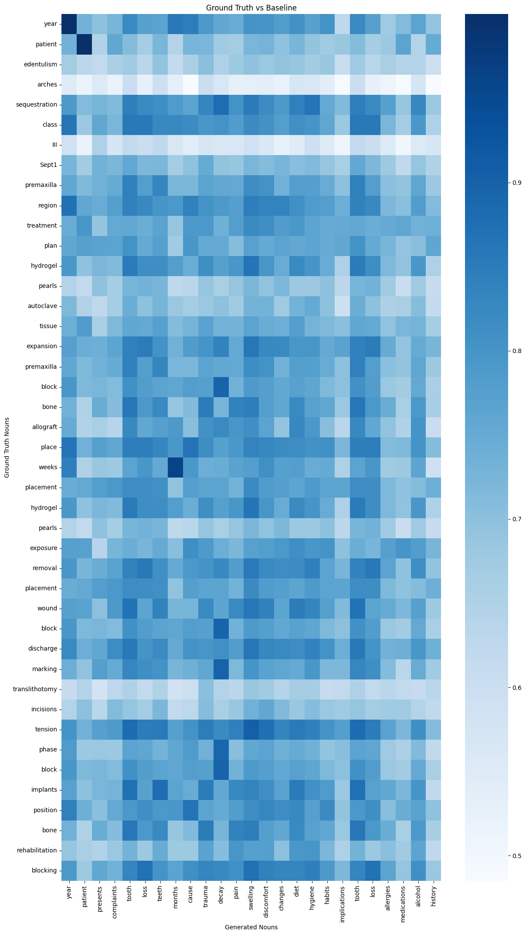
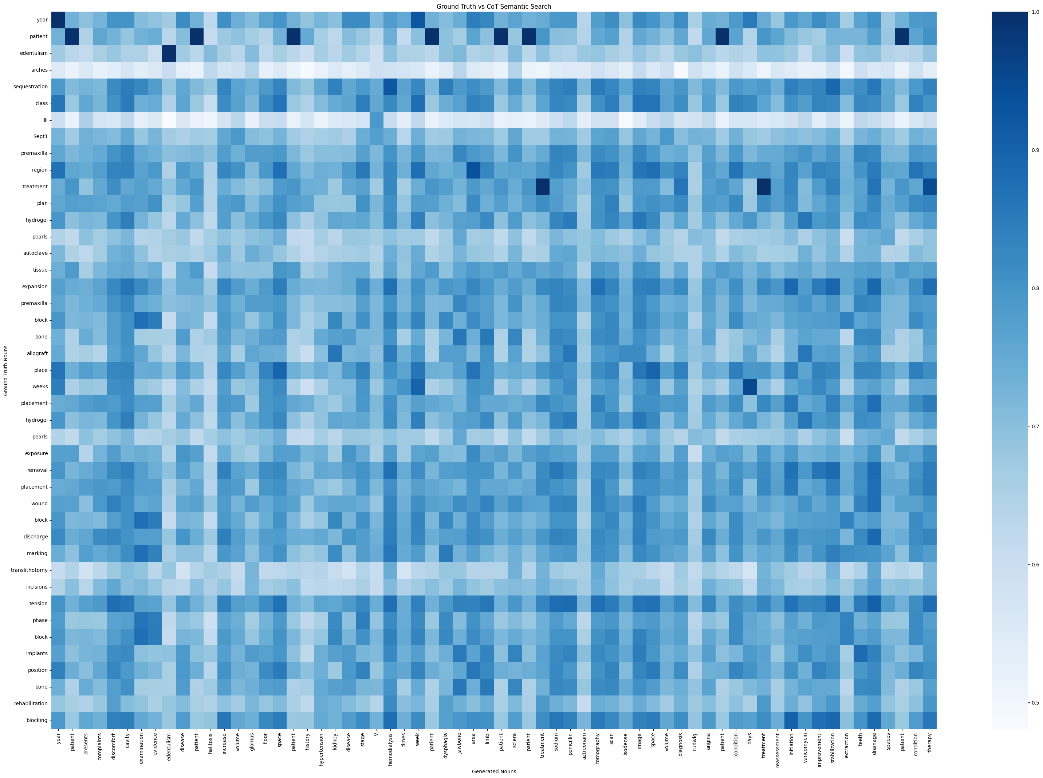
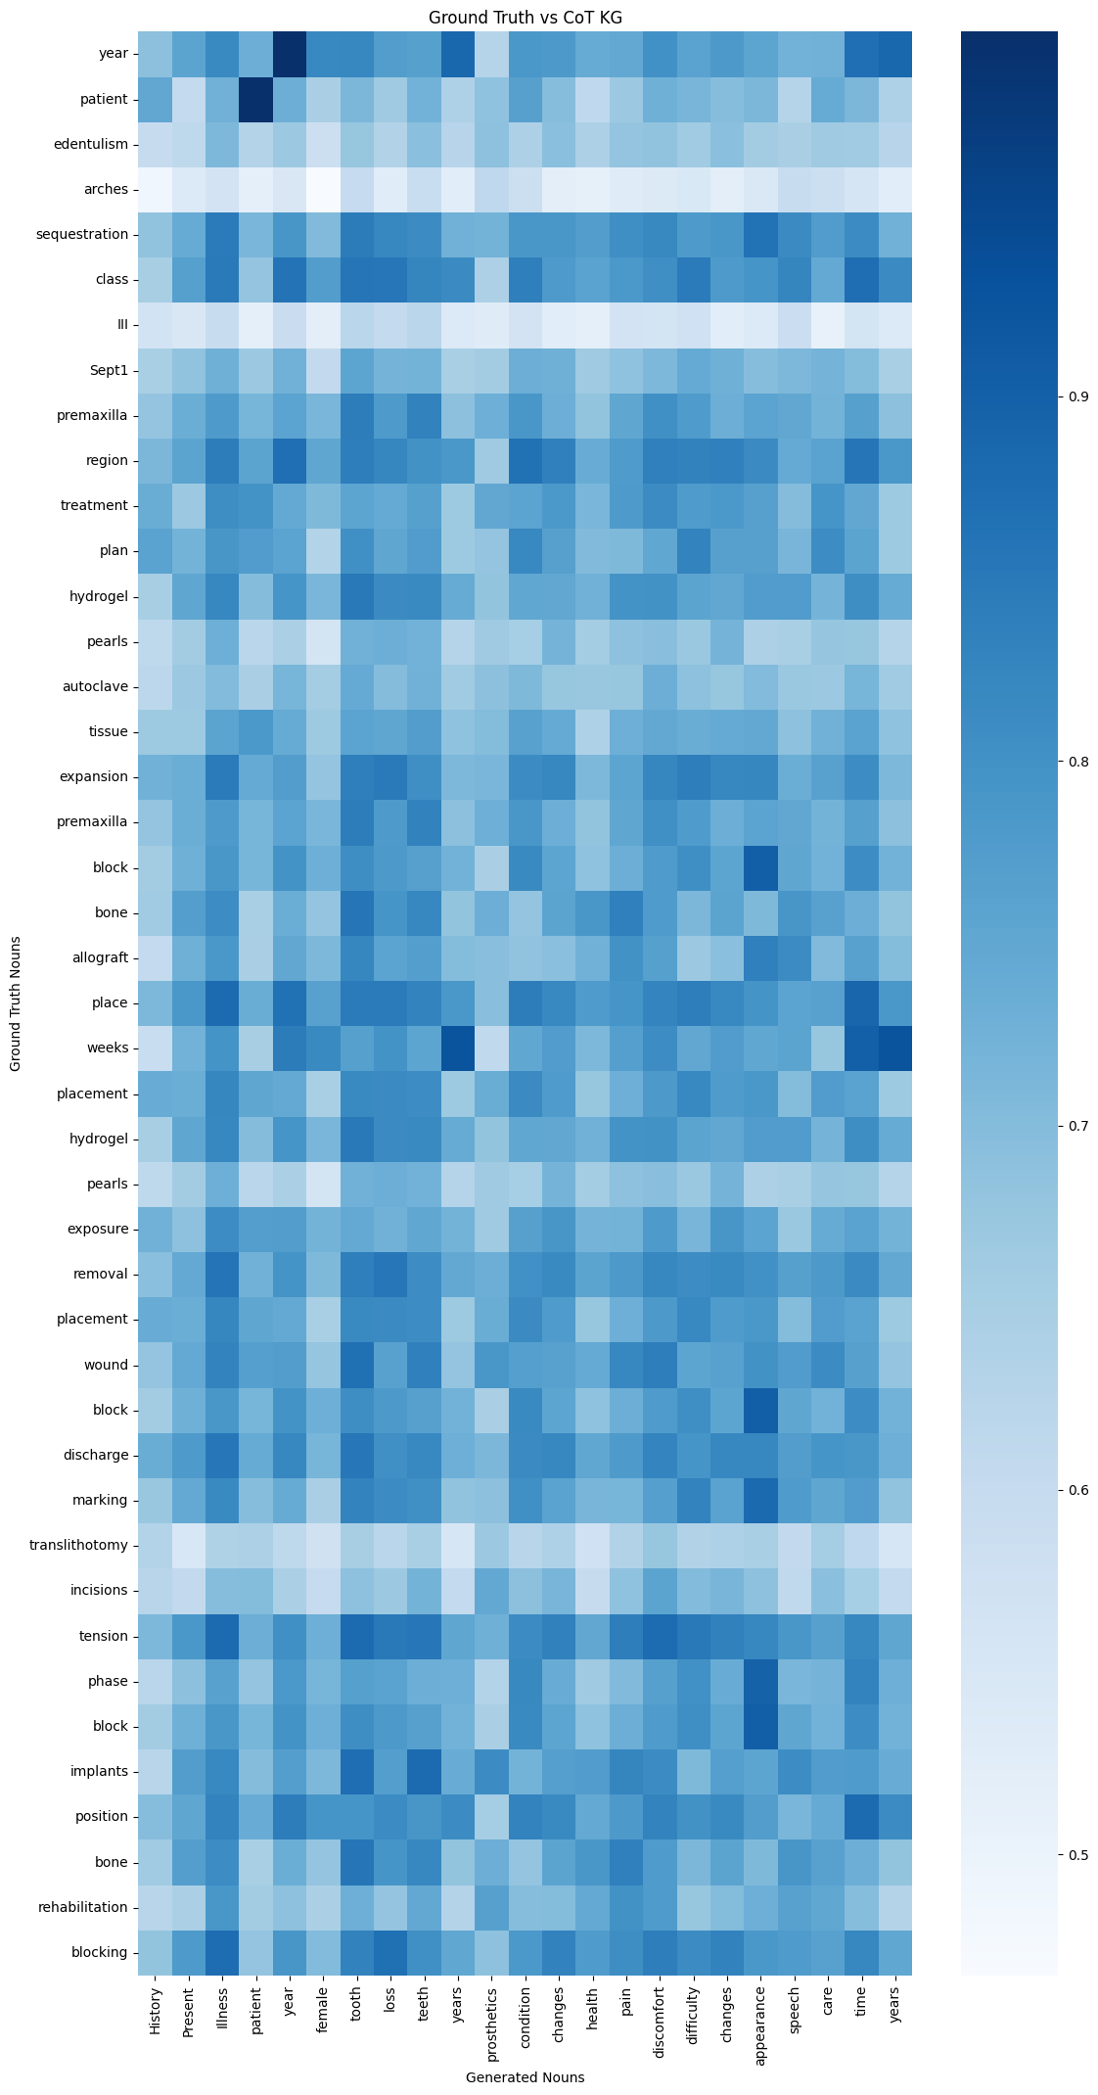
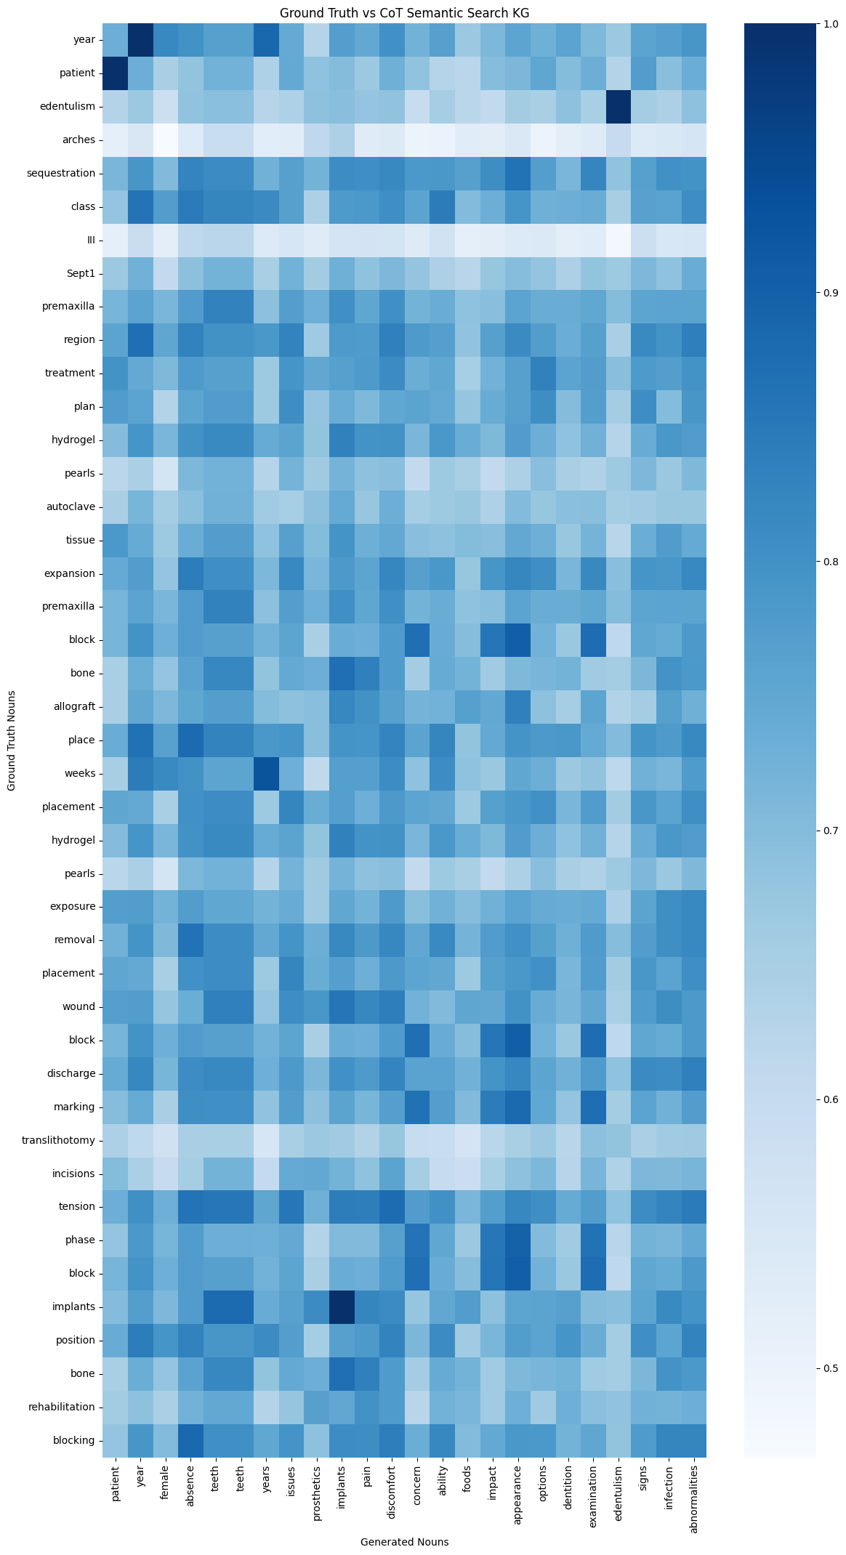
Sample #5
Clinical Case B:
ICD Code: K08109
Text Reference: edentulism
Result Samples:
BASELINE_R096_GENERATED_TEXT
COTSS_R095_GENERATED_TEXT
COTKG_R084_GENERATED_TEXT
COTSSKG_R078_GENERATED_TEXT
Baseline
CoT Semantic Search
CoT KG
CoT KG SS

